Slide 1
Boost Boards Modifications
VBSO / VBIAS

Slide 2
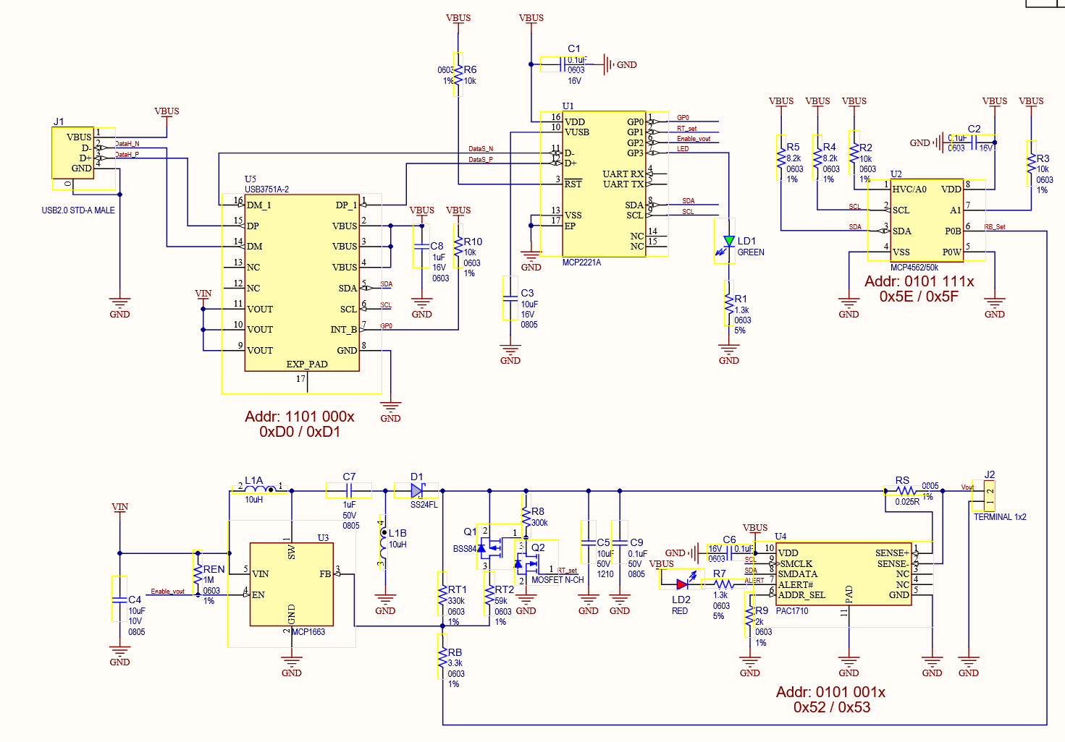
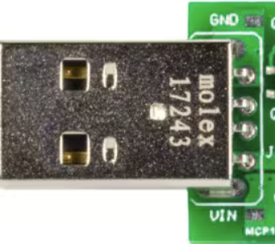



Replace USB
Connector
0x2F
Short Vin & Vbus
VBSO Board Modifications
Pot Addr – 0x2F
ADC Addr – 0x29
0x29
Replace it with 51K

Slide 3
Replace USB
Connector
0x2D
Short Vin & Vbus
VBAIS Board Modifications
POT Addr – 0x2D
ADC Addr – 0x18
0x18
Replace it with 51K

Slide 4
POT Value Setting for Boost
Sl.No | Salve Address VBSO / VBAIS | Register | Data | Comment
01 | 0x2F / 2D | 0x02 | 0x46 | Default code to set 5V ( do not try to go above 0x50 which will reduce boost voltage less then 5V, decrease value to increase the boost Voltage)
02 | 0x2F / 2D | 0x20 | 0x46 | Burn a default value ( voltage will be set default)
Read ADC Value
Sl.No | SalveAddress | Register | Data | Comment
01 | 0x29 / 0x18 | 0x0B | 0x5C | Configure ADC
02 | 0x29 / 0x18 | 0x0D | Vsense_LSB | Read lsb data
03 | 0x29 / 0x18 | 0x11 | Vsense_MSB | Read msb data
Adc data conversion:
Vsense = ((Vsense_MSB << 8 ) | Vsense_LSB) >> 5 #ignore Last 5Bits of the LSB data
FSV = (40 - 40/2047)
Vbus = FSVxVsense / 2047

